Slide 1
Mushroom Classification
Is it edible? Or is it poisonous?
Data Science Project by David Wan

Slide 2
As mushroom enthusiasts out in the wild, how can you tell whether a mushroom could potentially be edible or poisonous?

Slide 3
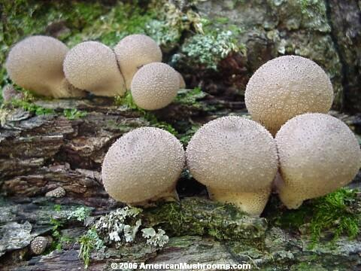
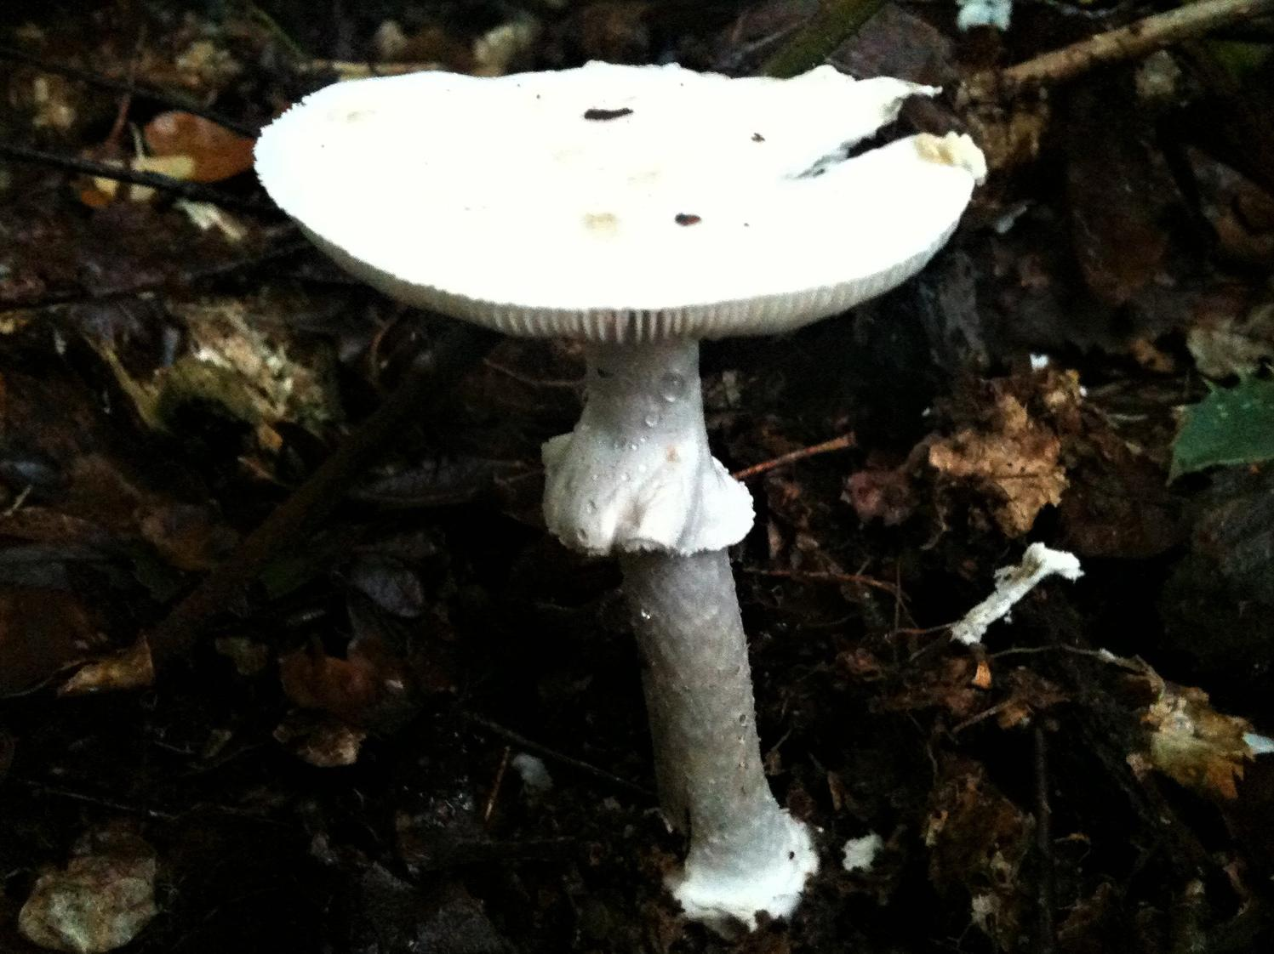
Edible vs Poisonous?
Source: https://americanmushrooms.com/edibles3.htm
Source: https://www.wildfooduk.com/mushroom-guide/destroying-angel/

Slide 4
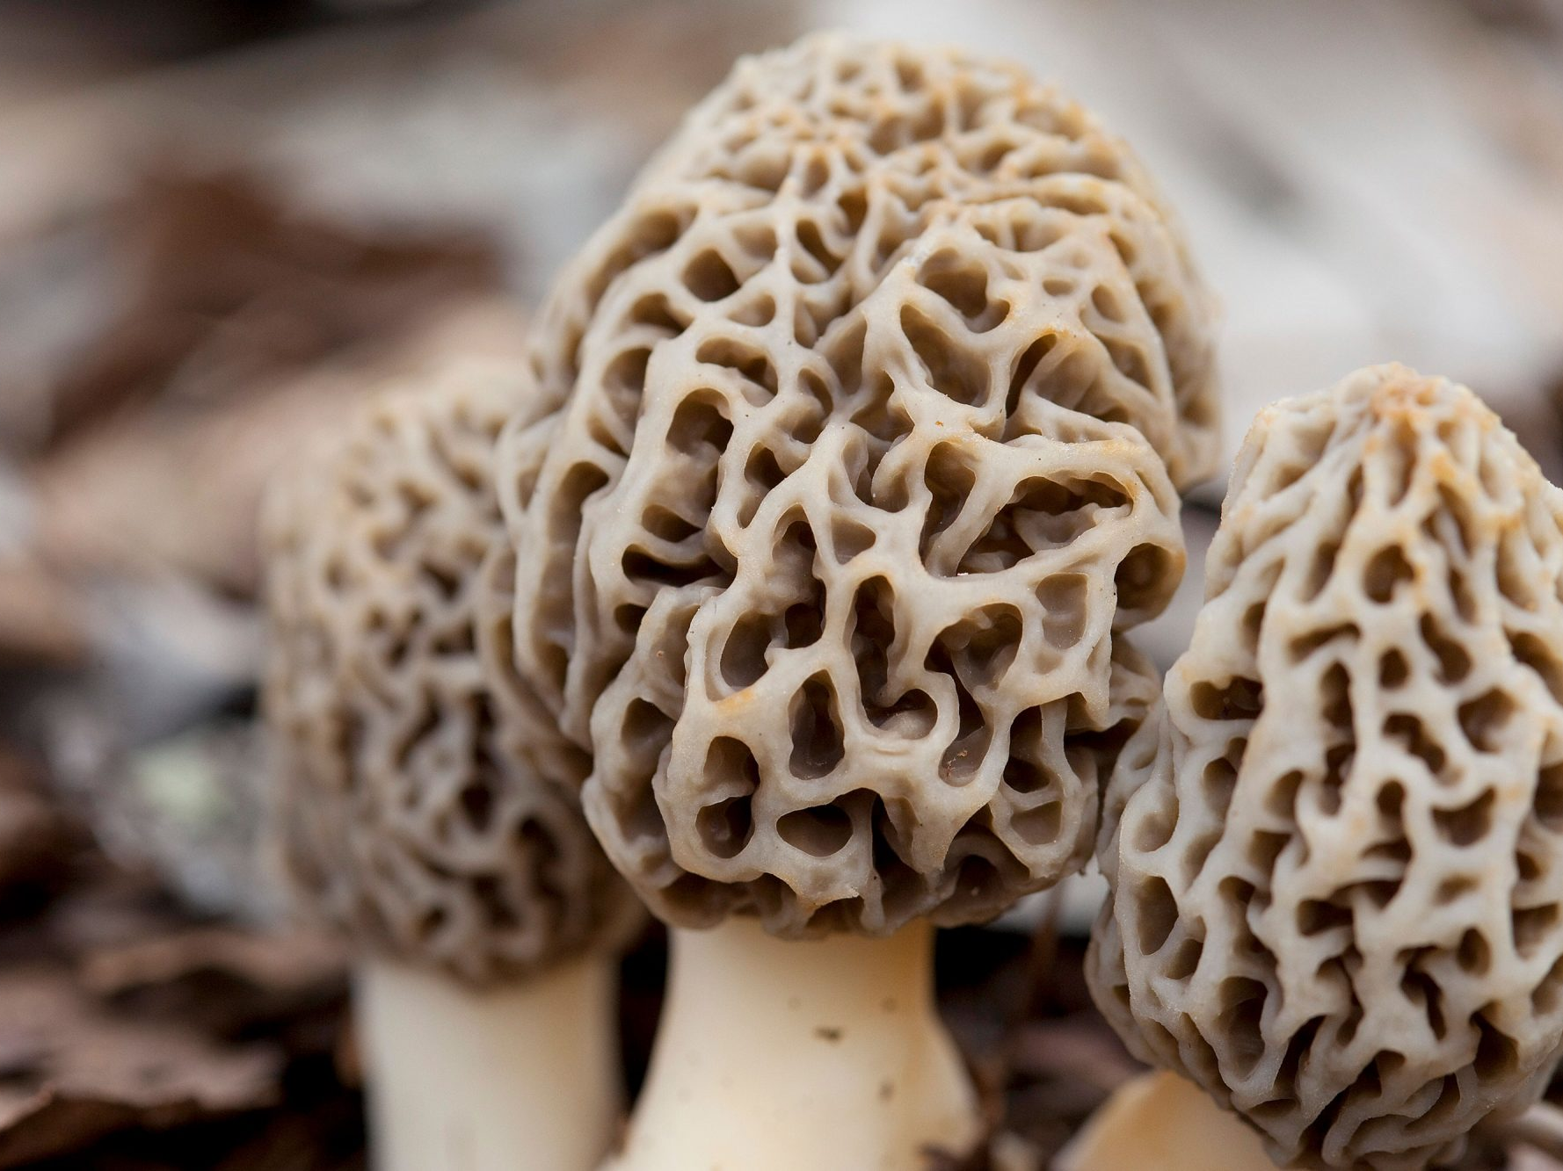
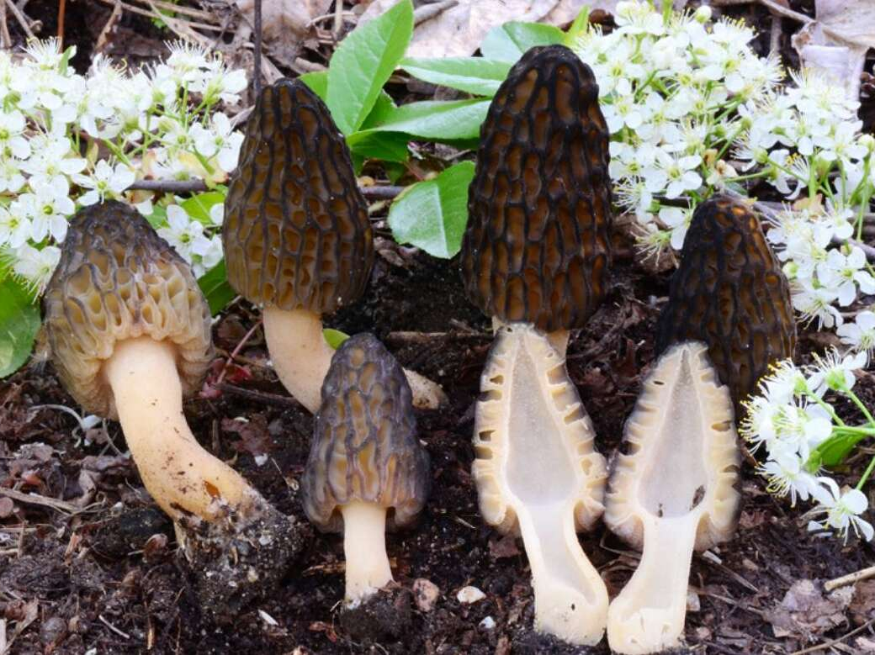
Edible vs Poisonous?
Source: https://www.allrecipes.com/article/what-are-morel-mushrooms/
Source: https://www.manisteenews.com/news/article/Don-t-get-fooled-by-these-morel-look-alikes-17062084.php

Slide 5
Project Overview
Source of dataset from Kaggle, courtesy of UCI Machine Learning repository
Use characteristics of mushrooms to identify whether they are edible or poisonous
Find correlations of certain features of mushrooms to help classify mushrooms
Employ machine learning modeling to make the most optimal predictions on classification of mushrooms

Slide 6
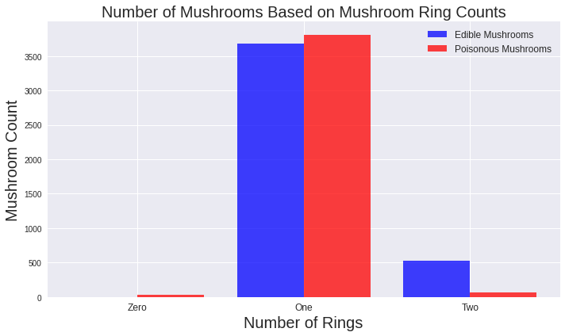
Classification by Mushroom Ring Counts

Slide 7
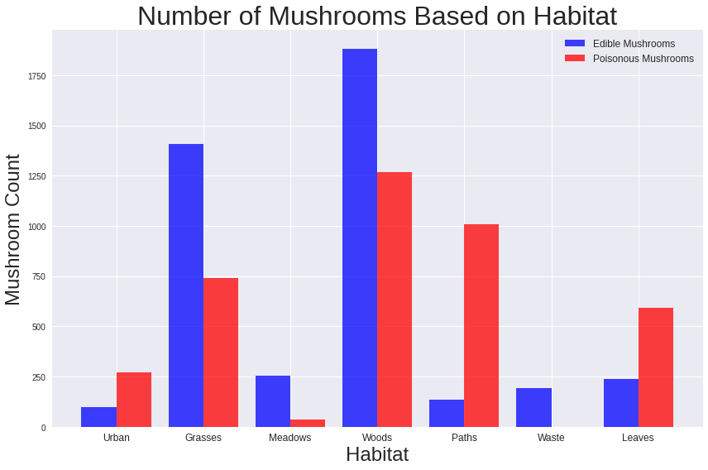
Classification by Mushroom Habitat

Slide 8
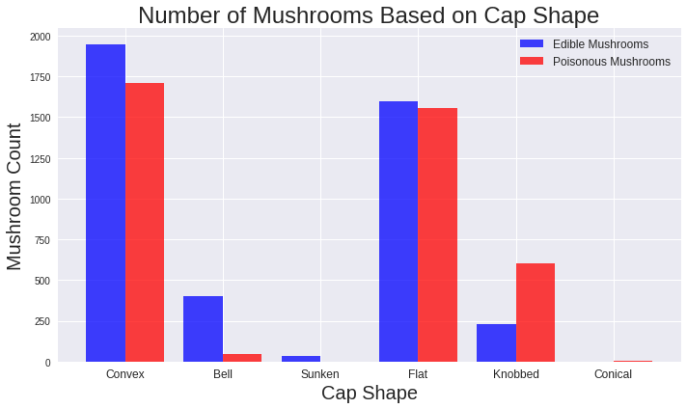
Classification by Mushroom Cap Shape

Slide 9
Model Strengths/Limitations
Model performed very well with near-perfect accuracy in identification of features that would allow classification of mushrooms as either edible or poisonous.
Large variety of mushrooms in the dataset made the modeling process reliable!
However, model does not take into account any potential mutations in the mushroom structure and characteristics.
More importantly, one small mistake by an amateur in feature identification for mushroom classification can mean the difference between life and death situations.
Mistaking poisonous mushrooms for edible ones may result in seizures, hallucinations, and possible even death!
If in doubt, do not attempt to consume wild mushrooms!

Slide 10
Final Recommendations
Understand characteristics of poisonous mushrooms (i.e. white spore markings, white gills, bright red cap colors, etc.)
Stick to supermarkets and grocery stores if using mushrooms for culinary purposes
Do not eat any mushrooms in your backyard or local parks; more often than not, they are poisonous!
If planning on consuming wild mushrooms, always have a mushroom expert on hand to make the final determination on mushroom classification.

Slide 11
References
GitHub repository: https://github.com/davidwan08/Mushroom-Classification-Modeling-and-Analysis-Project
Kaggle dataset: https://www.kaggle.com/datasets/uciml/mushroom-classification
Puffball image link: https://americanmushrooms.com/edibles3.htm
Destroying Angel image link: https://www.wildfooduk.com/mushroom-guide/destroying-angel/
Morels image link: https://www.allrecipes.com/article/what-are-morel-mushrooms/
False Morels image link: https://www.manisteenews.com/news/article/Don-t-get-fooled-by-these-morel-look-alikes-17062084.php

